Slide 1













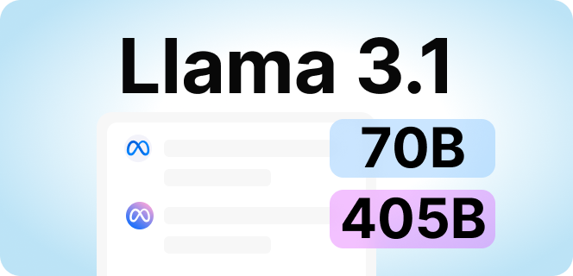






ShutterUp

Slide 2
ShutterUp
ShutterUp 快拍

Slide 3
ShutterUp
ShutterUp 快拍
User-friendly Photography commission platform

Slide 4
ShutterUp
function?

Slide 5
ShutterUp
We have something

Slide 6
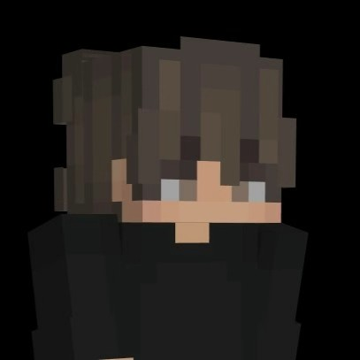
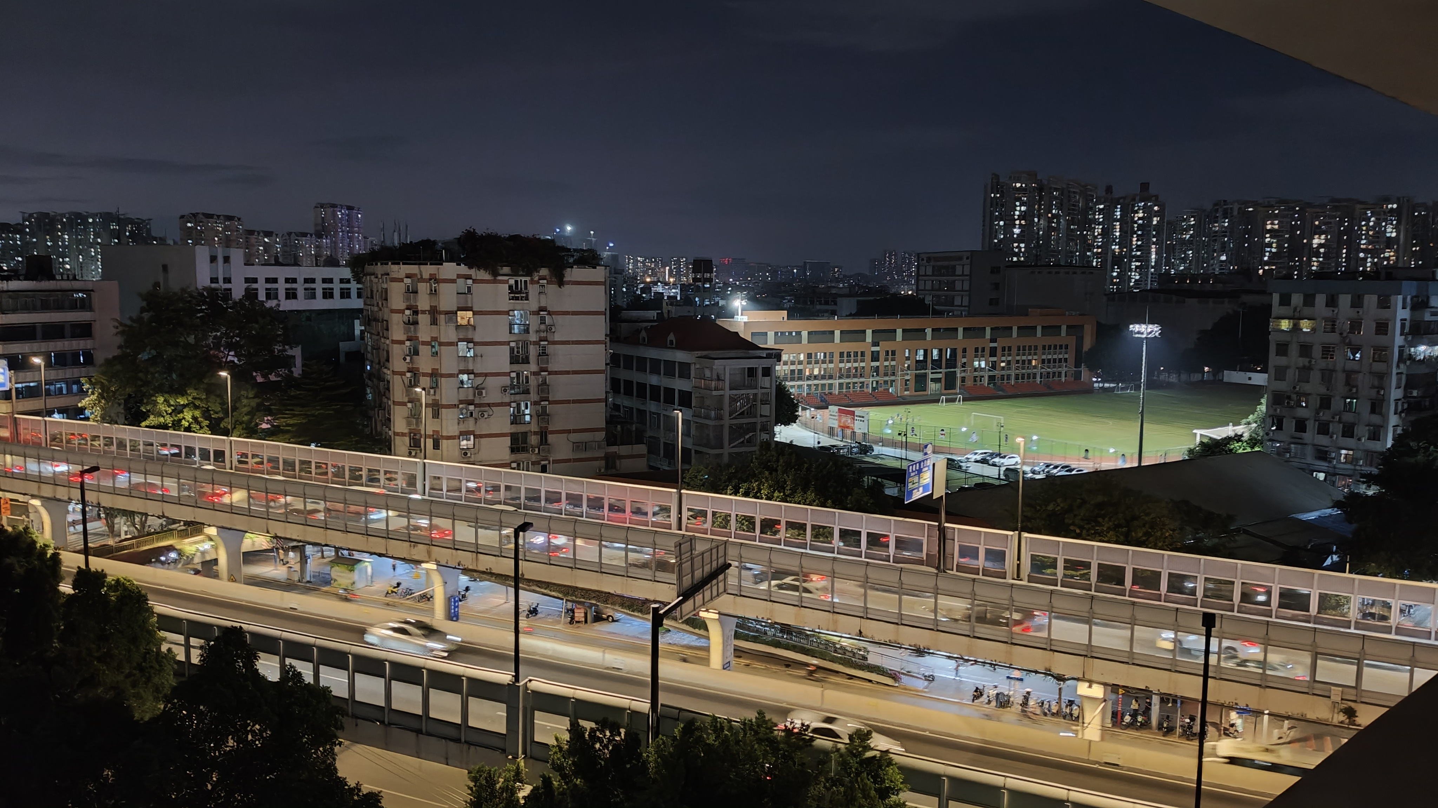

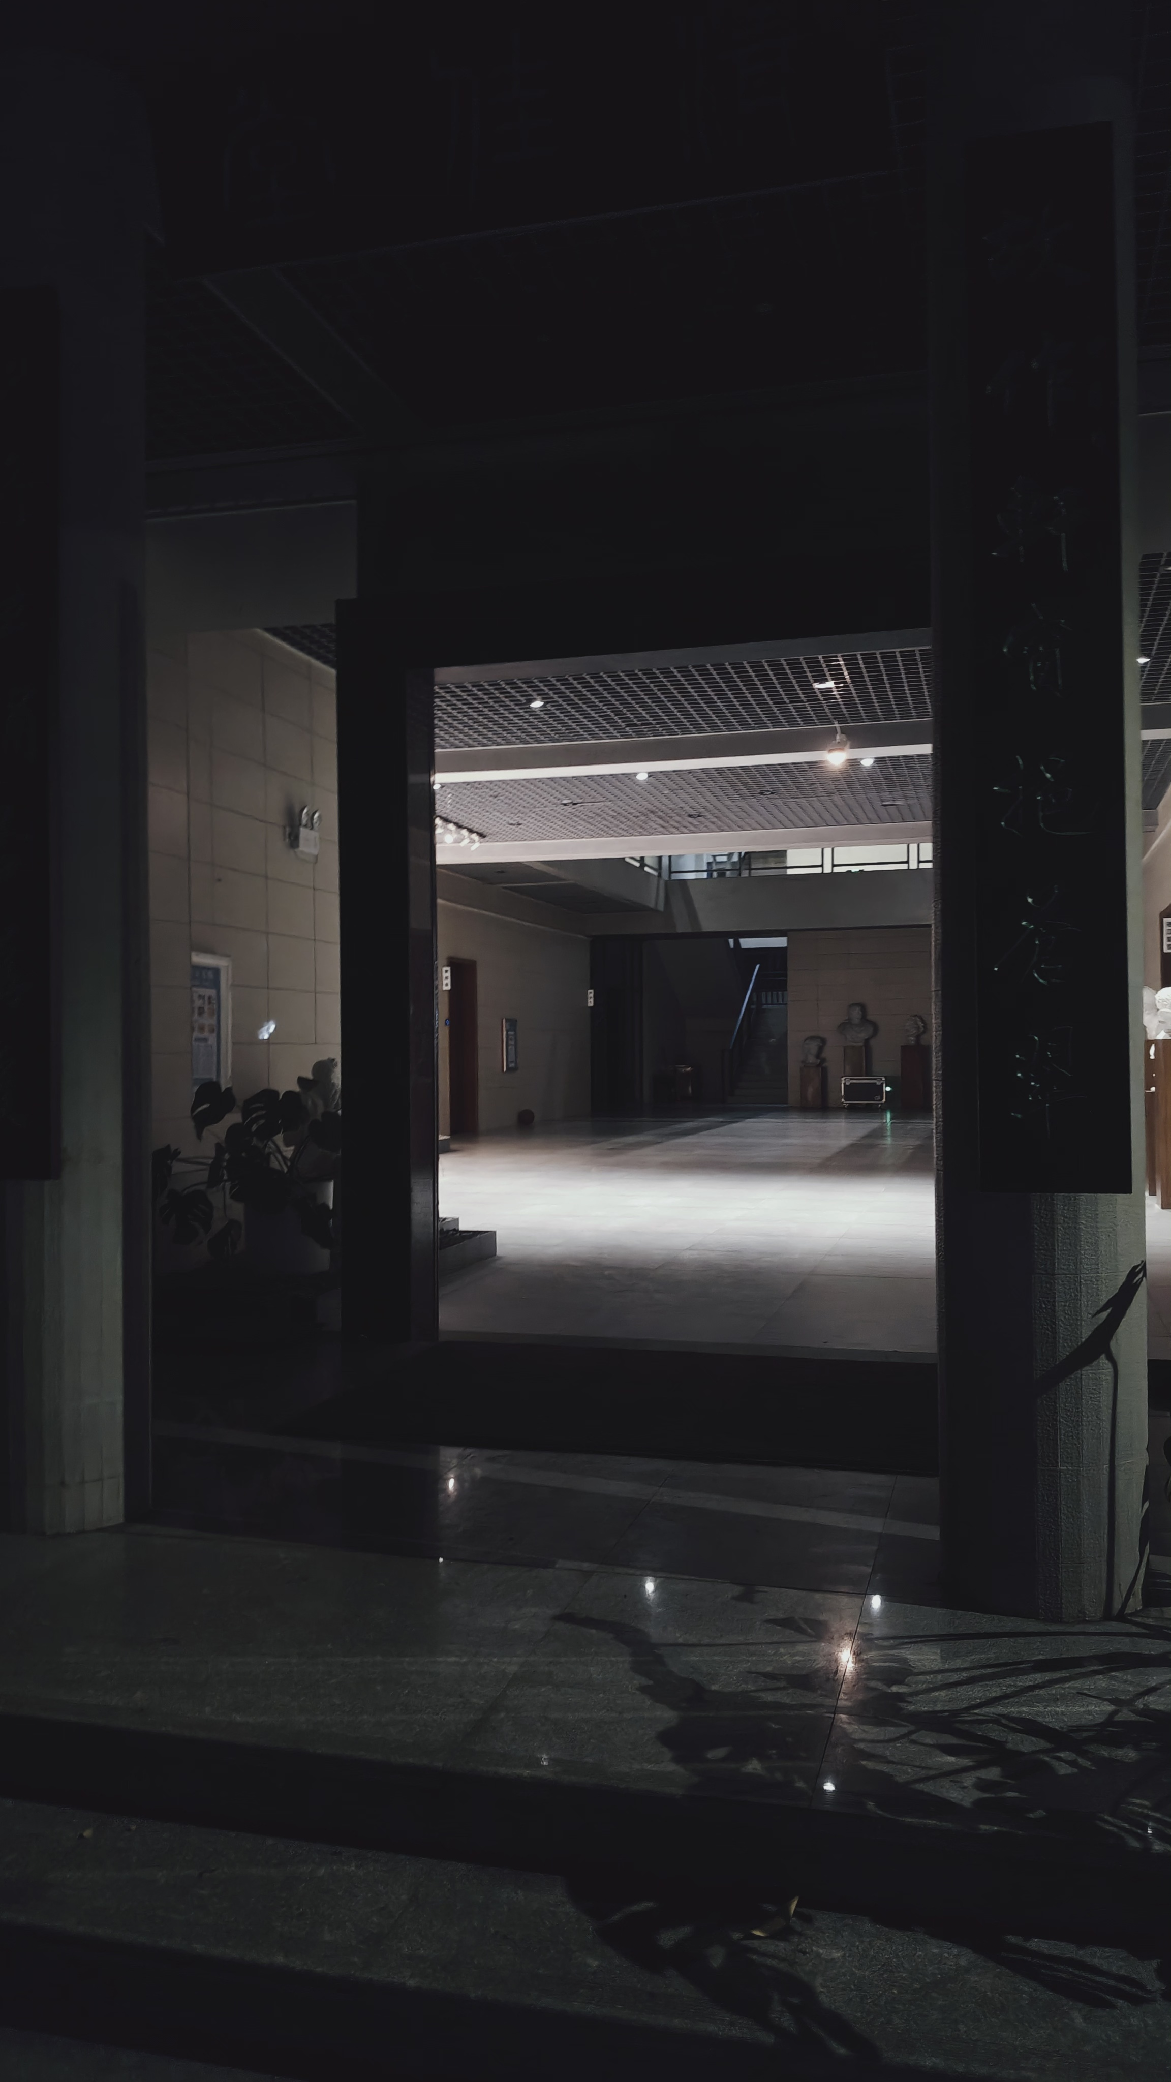





Link Space
ShutterUp
New :)
< Your Link Sapce
SailsHuang
清佳堂。
广东广雅中学（荔湾校区） - 清佳堂

Slide 7
ShutterUp
Let’s add more excitement to the

Slide 8
Link Space
ShutterUp
Show.
< Your Link Sapce
SailsHuang
清佳堂。
广东广雅中学（荔湾校区） - 清佳堂

Slide 9
ShutterUp
Link Space
< Your Link Sapce
SailsHuang
清佳堂。
广东广雅中学（荔湾校区） - 清佳堂

Slide 10

ShutterUp
Link Space
Ready to Share anything
< Your Link Sapce
SailsHuang
清佳堂。
广东广雅中学（荔湾校区） - 清佳堂

Slide 11
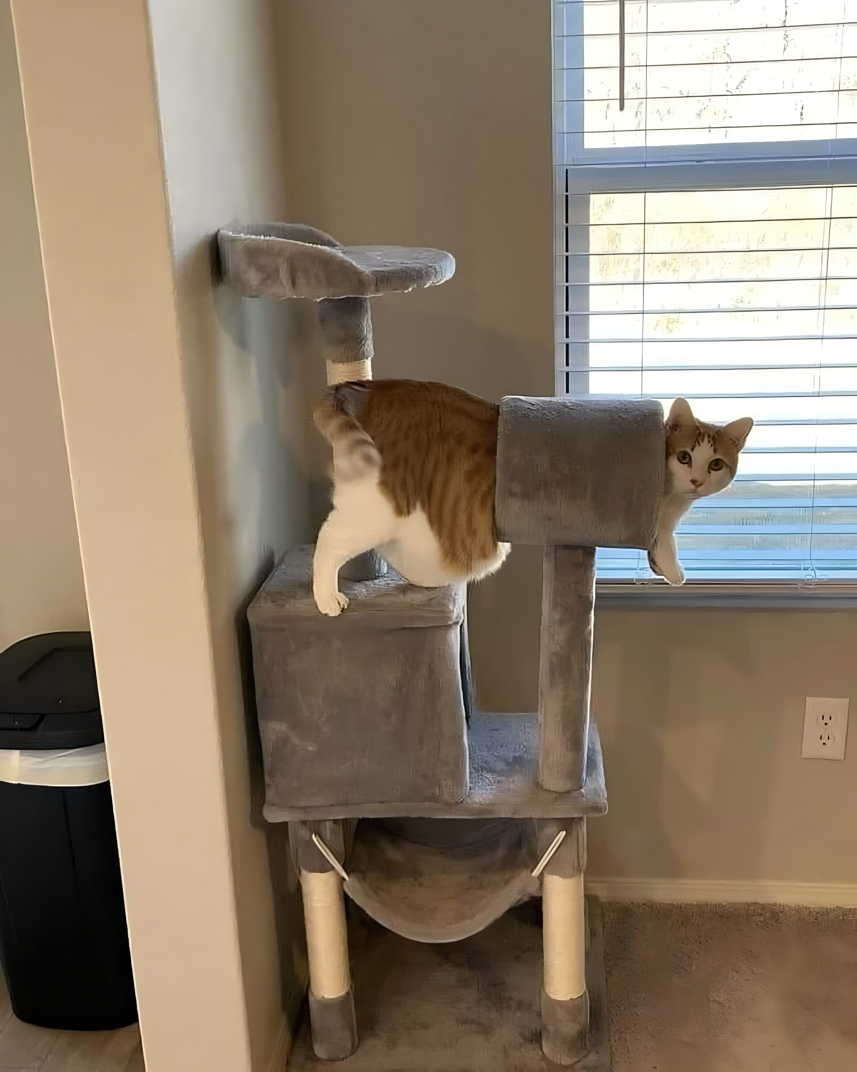


ShutterUp
Link Space
Ready to Share anything
< Your Link Sapce
< Link Space
We are going to link you with others!
SailsHuang
Xycon.
Emotional Damage!!
What the hell of the Xiaomi 15 Ultra??
Oneplus 13 is my only LOVE!!
ONEPLUS STAND UP!!!
广东广州
清佳堂。
Peregrine Bian
广东广雅中学（荔湾校区） - 清佳堂

Slide 12
ShutterUp
Link Space
Ready to Share anything
< Your Link Sapce
Check all you can image!
Link Space is a community all over the world.
Not Only Pictures, 4K Videos, GIFs, And Apple/OPPO Live images!,
< Link Space
SailsHuang
Xycon.
Emotional Damage!!
What the hell of the Xiaomi 15 Ultra??
Oneplus 13 is my only LOVE!!
ONEPLUS STAND UP!!!
广东广州
清佳堂。
Peregrine Bian
广东广雅中学（荔湾校区） - 清佳堂

Slide 13
< Link Space
ShutterUp
Link Space
Ready to Share anything
< Your Link Space
Check all you can image!
Link Space is a community all over the world.
Not Only Pictures, 4K Videos, GIFs, And Apple/OPPO Live images!,
Xycon.
Emotional Damage!!
What the hell of the Xiaomi 15 Ultra??
Oneplus 13 is my only LOVE!!
ONEPLUS STAND UP!!!
SailsHuang
And also Texts.
Write something here...
@
广东广州
Peregrine Bian
清佳堂。
广东广雅中学（荔湾校区） - 清佳堂

Slide 14
ShutterUp
Link Space
Ready to Share anything
You can still add comments to the post now.
< Link Space
Emotional Damage!!
What the hell of the Xiaomi 15 Ultra??
Oneplus 13 is my only LOVE!!
ONEPLUS STAND UP!!!
广东广州
Peregrine Bian
Write something here...
@

Slide 15
ShutterUp
Link Space
Ready to Share anything
You can still add comments to the post now.
< Link Space
And like the posts you enjoy.
Emotional Damage!!
What the hell of the Xiaomi 15 Ultra??
Oneplus 13 is my only LOVE!!
ONEPLUS STAND UP!!!
广东广州
Already liked it.
Peregrine Bian
Follow
Write something here...
@

Slide 16
ShutterUp
Link Space
Ready to Share anything
< Your Link Space
< Link Space
All in your ShutterUp!
SailsHuang
Xycon.
Emotional Damage!!
What the hell of the Xiaomi 15 Ultra??
Oneplus 13 is my only LOVE!!
ONEPLUS STAND UP!!!
Emotional Damage!!
What the hell of the Xiaomi 15 Ultra??
Oneplus 13 is my only LOVE!!
ONEPLUS STAND UP!!!
Write something here...
@
广东广州
广东广州
Already liked it.
清佳堂。
Peregrine Bian
Peregrine Bian
Follow
广东广雅中学（荔湾校区） - 清佳堂

Slide 17
ShutterUp
Link Space
< Your Link Sapce
SailsHuang
清佳堂。
广东广雅中学（荔湾校区） - 清佳堂

Slide 18
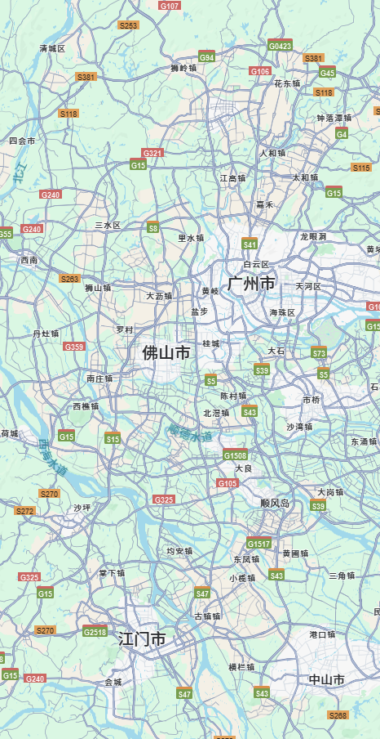
ShutterUp
Photography commission
< Photography co...
80%
约稿城市
广东省佛山市三水区里水镇
约稿地点
大步工业区
选择您的偏好！
日落
无人跟随
产品摆拍
旅行随拍
展览摆拍
日出
傍晚
街拍
拍人
月落
下午
水下摄影
航拍
拍景
凌晨
水下摄影
月出
专业摄影
沙滩随拍&摆拍
上午
晚上
漫展随拍
保存
现在约稿

Slide 19
Photography commission
ShutterUp
Photography commission
Get your picture without you
< Photography co...
80%
约稿城市
广东省佛山市三水区里水镇
约稿地点
大步工业区
选择您的偏好！
日落
无人跟随
产品摆拍
旅行随拍
展览摆拍
日出
傍晚
街拍
拍人
月落
下午
水下摄影
航拍
拍景
凌晨
水下摄影
月出
专业摄影
沙滩随拍&摆拍
上午
晚上
漫展随拍
保存
现在约稿

Slide 20
ShutterUp
Photography commission
Get your picture without you
< Photography co...
Now, you can complete the booking and confirmation of photographers with just as simple steps as
ordering food on the Meituan app
or
hailing a vehicle on the Didi Chuxing app.
80%
约稿城市
广东省佛山市三水区里水镇
约稿地点
大步工业区
选择您的偏好！
日落
无人跟随
产品摆拍
旅行随拍
展览摆拍
日出
傍晚
街拍
拍人
月落
下午
水下摄影
航拍
拍景
凌晨
水下摄影
月出
专业摄影
沙滩随拍&摆拍
上午
晚上
漫展随拍
保存
现在约稿

Slide 21
ShutterUp
< Photography co...
80%
约稿城市
广东省佛山市三水区里水镇
约稿地点
大步工业区
选择您的偏好！
日落
无人跟随
产品摆拍
旅行随拍
展览摆拍
日出
傍晚
街拍
拍人
月落
下午
水下摄影
航拍
拍景
凌晨
水上摄影
月出
专业摄影
沙滩随拍&摆拍
上午
晚上
漫展随拍
保存
现在约稿

Slide 22
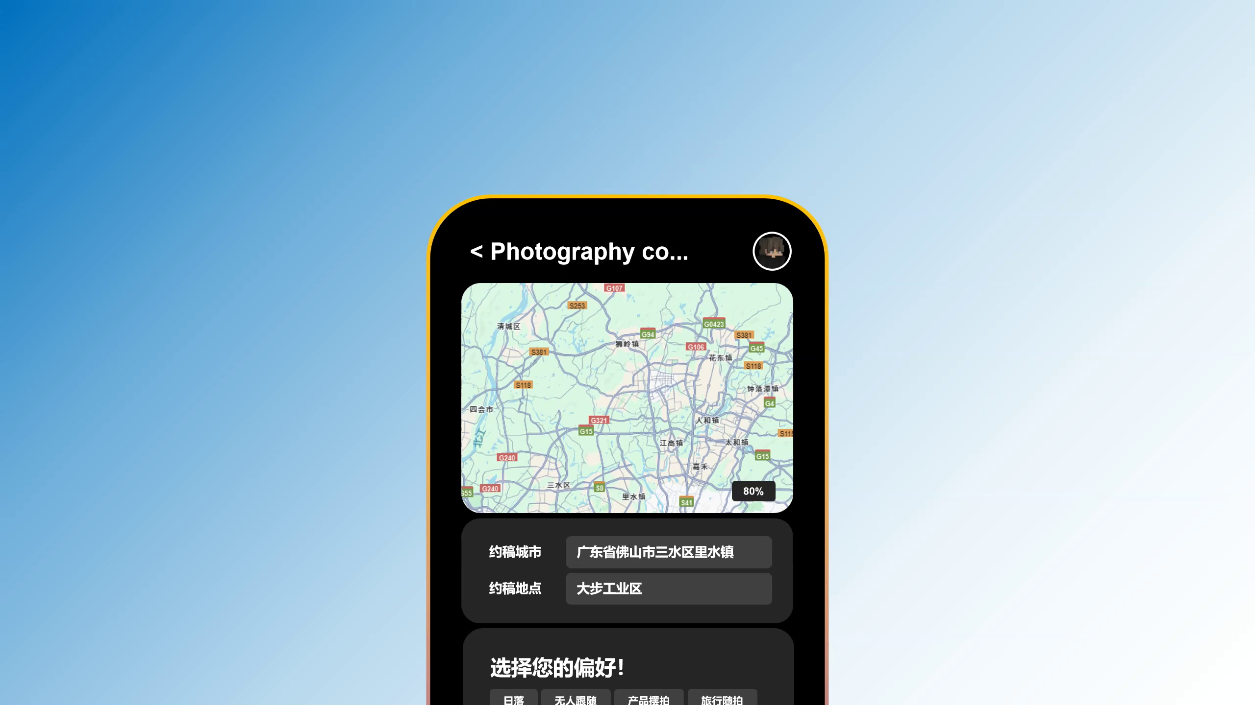

Slide 23
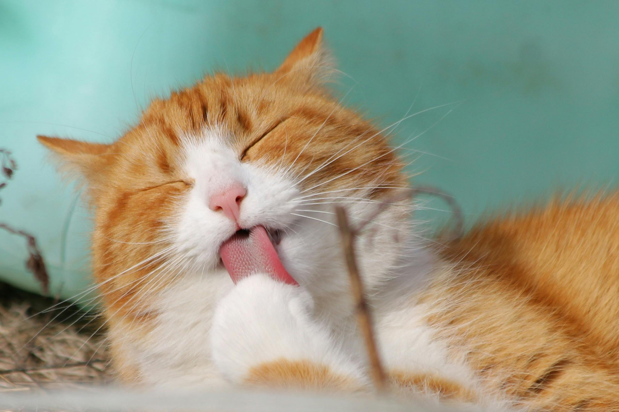
ShutterUp
< Photography co...
80%
约稿城市
广东省佛山市三水区里水镇
约稿地点
大步工业区
已经找到摄影师（专业）！
她距离约稿地点还有 4.6公里（35分钟） ，和她沟通您的喜好吧！
没有猫猫没有生活
（已实名：程*海）
社区认证5级专业摄影师—
服务态度好-- 摄影手法专业--
查看她的主页
查看过往服务
联系摄影师
确定

Slide 24
ShutterUp
Photography commission
Get your picture without you
< Photography co...
With click on your favourite Tags and click a botton for the end.
You can get your own photographer, and...
Enjoy the photos.
< Photography co...
80%
80%
约稿城市
广东省佛山市三水区里水镇
约稿城市
广东省佛山市三水区里水镇
约稿地点
大步工业区
约稿地点
大步工业区
选择您的偏好！
已经找到摄影师（专业）！
她距离约稿地点还有 4.6公里（35分钟） ，和她沟通您的喜好吧！
日落
无人跟随
产品摆拍
旅行随拍
展览摆拍
日出
傍晚
街拍
拍人
没有猫猫没有生活
（已实名：程*海）
社区认证5级专业摄影师—
服务态度好-- 摄影手法专业--
月落
下午
水下摄影
航拍
拍景
凌晨
水下摄影
月出
专业摄影
沙滩随拍&摆拍
上午
晚上
漫展随拍
查看她的主页
查看过往服务
保存
现在约稿
联系摄影师
确定

Slide 25
ShutterUp
Photography commission
Get your picture without you
< Photography co...
We are caring about your safe and privacy, so we require all photographers available for orders to undergo
< Photography co...
80%
80%
约稿城市
广东省佛山市三水区里水镇
约稿城市
广东省佛山市三水区里水镇
约稿地点
大步工业区
约稿地点
大步工业区
选择您的偏好！
已经找到摄影师（专业）！
她距离约稿地点还有 4.6公里（35分钟） ，和她沟通您的喜好吧！
日落
无人跟随
产品摆拍
旅行随拍
展览摆拍
日出
傍晚
街拍
拍人
没有猫猫没有生活
（已实名：程*海）
社区认证5级专业摄影师—
服务态度好-- 摄影手法专业--
月落
下午
水下摄影
航拍
拍景
凌晨
水下摄影
月出
专业摄影
沙滩随拍&摆拍
上午
晚上
漫展随拍
查看她的主页
查看过往服务
保存
现在约稿
联系摄影师
确定

Slide 26
< Photography co...
ShutterUp
Photography commission
80%
Get your picture without you
约稿城市
广东省佛山市三水区里水镇
约稿地点
大步工业区
< Photography co...
We are caring about your safe and privacy, so we require all photographers available for orders to undergo
已经找到摄影师（专业）！
她距离约稿地点还有 4.6公里（35分钟） ，和她沟通您的喜好吧！
RPV (Real Person Verification).
没有猫猫没有生活
（已实名：程*海）
社区认证5级专业摄影师—
服务态度好-- 摄影手法专业--
查看她的主页
查看过往服务
80%
联系摄影师
确定
约稿城市
广东省佛山市三水区里水镇
约稿地点
大步工业区
选择您的偏好！
日落
无人跟随
产品摆拍
旅行随拍
展览摆拍
日出
傍晚
街拍
拍人
月落
下午
水下摄影
航拍
拍景
凌晨
水下摄影
月出
专业摄影
沙滩随拍&摆拍
上午
晚上
漫展随拍
保存
现在约稿

Slide 27
ShutterUp
Photography commission
< Photography co...
80%
约稿城市
广东省佛山市三水区里水镇
约稿地点
大步工业区
选择您的偏好！
日落
无人跟随
产品摆拍
旅行随拍
展览摆拍
日出
傍晚
街拍
拍人
月落
下午
水下摄影
航拍
拍景
凌晨
水下摄影
月出
专业摄影
沙滩随拍&摆拍
上午
晚上
漫展随拍
保存
现在约稿

Slide 28


ShutterUp
AI ability & Online Tools
< Search/Tools
AI Chat Tools
AI Visual Tools
LinkSpace AI (Beta)
Other AI (NDAI)
Online Tools

Slide 29



Nothingness Domain 虚领
ShutterUp
ShutterUp
AstanAI 4.0 is insert with the AI Visual Tools

Slide 30
ShutterUp
Nothingness Domain 虚领
ShutterUp
Powered By

Slide 31
Nothingness Domain 虚领
ShutterUp

Slide 32
Visual AI
Nothingness Domain 虚领
ShutterUp
We are More intelligent and fast
< Search/Tools/AI/V
Photo editing
GItI
Image Generation
Life Log

Slide 33
Nothingness Domain 虚领
ShutterUp
Visual AI
< Search/Tools/AI/V
Photo editing
GItI
Image Generation
Life Log

Slide 34
Visual AI
Nothingness Domain 虚领
ShutterUp
AI XDR
< Search/Tools/AI/V
Photo editing
GItI
Image Generation
Life Log

Slide 35
Nothingness Domain 虚领
ShutterUp
AI XDR
70% of people are very much looking forward to the visual features of Apple Intelligence.

Slide 36
Nothingness Domain 虚领
ShutterUp
AI XDR
Now, we are coming.

Slide 37
Nothingness Domain 虚领
ShutterUp
AI XDR
The strongest AI visual color optimization

Slide 38
Nothingness Domain 虚领
ShutterUp
AI XDR
The strongest AI visual color optimization
< Link Space
AI XDR can help restore the original colors of images.
广东广州
Xycon.
Following
Xycon.
Fat Cat!
It might because of the butter =( #Cat#
Write something here...
@

Slide 39
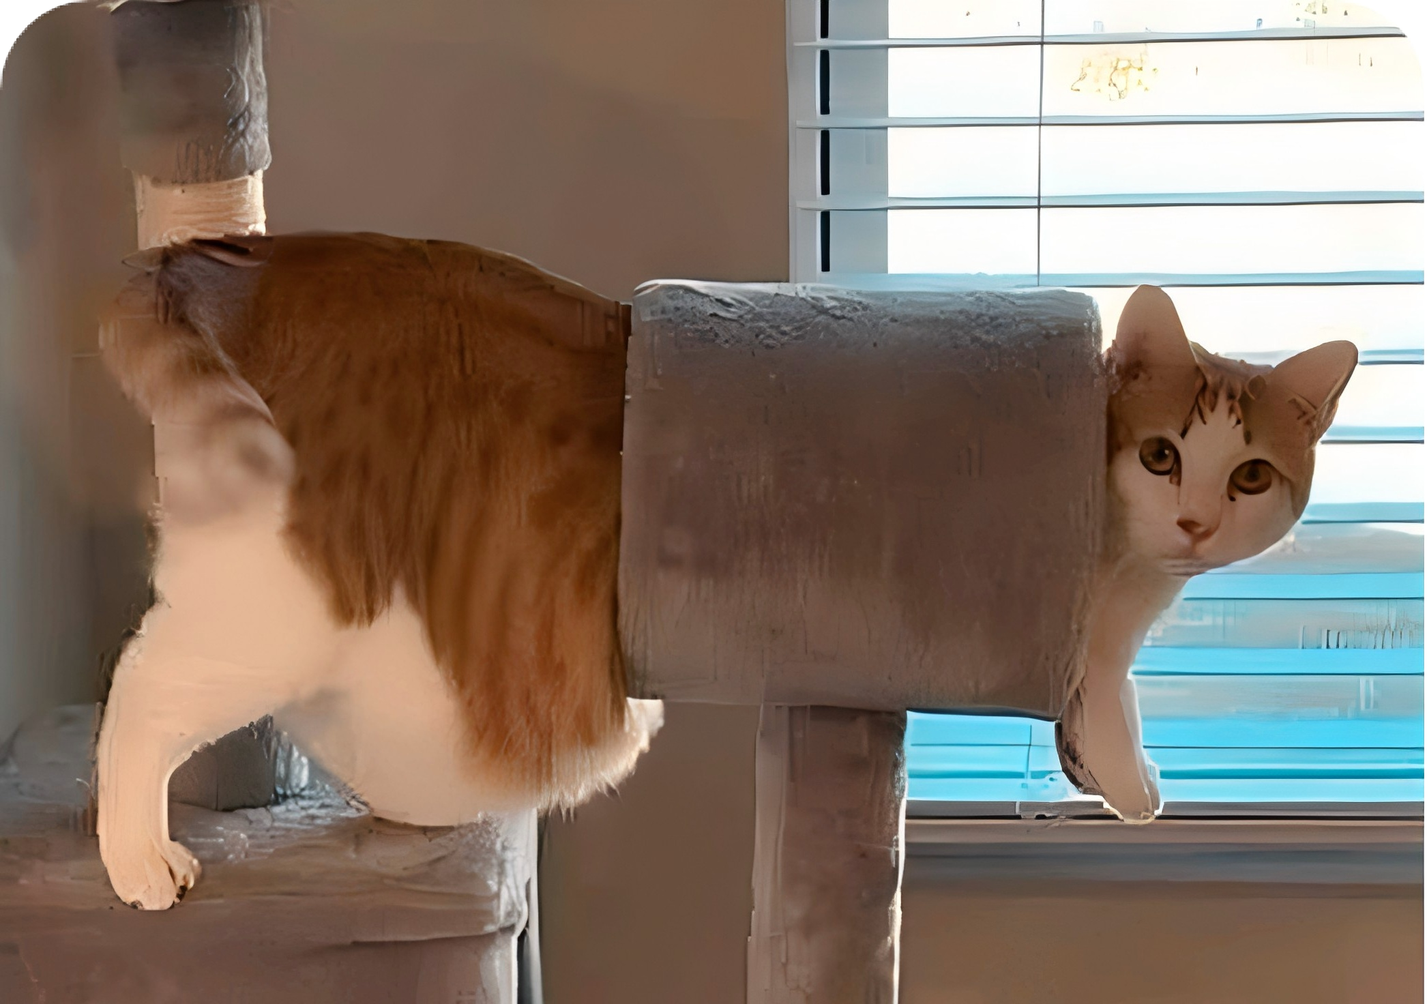
Nothingness Domain 虚领
ShutterUp
AI XDR
The strongest AI visual color optimization
< Link Space
AI XDR can help restore the original colors of images.
广东广州
AI XDR
Xycon.
Following
Xycon.
Fat Cat!
It might because of the butter =( #Cat#
Write something here...
@

Slide 40
143%
Nothingness Domain 虚领
ShutterUp
AI XDR
The strongest AI visual color optimization
< Link Space
AI XDR can help restore the original colors of images.
NDAI™'s powerful Astan AI 4.0 visual engine discards generative intelligence（GPT）, adopting a more biomimetic CoT-integrated neuron-like network derivative artificial intelligence (CoT-NND).
This helps every user to immerse themselves more deeply into the world in front of the lens and behind the screen.
广东广州
AI XDR
Xycon.
Following
Xycon.
Fat Cat!
It might because of the butter =( #Cat#
Write something here...
@

Slide 41
119%
Nothingness Domain 虚领
ShutterUp
143%
Minimum quality improvement ratio
(4K -> 8K, file size increases proportionally)

Slide 42
40x
Nothingness Domain 虚领
ShutterUp
119%
Minimum color gamut enhancement ratio
(1024 -> 2048, varies due to encoding)

Slide 43
Visual AI
Nothingness Domain 虚领
ShutterUp
40x
Faster XDR generation speed (compared to the speed of OnePlus 13 Pro)
< Search/Tools/AI/V
Photo editing
GItI
Image Generation
Life Log

Slide 44
Nothingness Domain 虚领
ShutterUp
Visual AI
< Search/Tools/AI/V
Photo editing
GItI
Image Generation
Life Log

Slide 45
Visual AI
< Search/Tools/AI/V
Nothingness Domain 虚领
ShutterUp
Photo editing
GItI
Image Generation
Life Log
AI Picture live
AI XDR
AI Image Recognition

Slide 46
< Search/Tools/AI/V
Nothingness Domain 虚领
ShutterUp
Photo editing
GItI
Life Log
AI XDR
Visual AI
AI Picture live
Image Generation
AI Image Recognition

Slide 47
Visual AI
Photo editing
GItI
Nothingness Domain 虚领
ShutterUp
Life Log
AI XDR
Now back to ShutterUp
AI Picture live
Image Generation
AI Image Recognition

Slide 48
ShutterUp
Now back to ShutterUp
Why “ShutterUp”
Shutter
Up

Slide 49
ShutterUp
Now back to ShutterUp
Why “ShutterUp”
Shutter
Up

Slide 50
ShutterUp
Now back to ShutterUp
Why “ShutterUp”
Shutter
Up
The shutter is a mechanical or electronic device in cameras that controls the exposure time. When the shutter button on the camera is pressed, the shutter quickly opens and closes, allowing light to shine onto the camera's sensor for a certain period, thus capturing the image. In simple terms, the shutter acts like the "eyelid" that controls the opening and closing of the camera's "eye".
"In Chinese, 'Up' usually means 'upward', 'rise', or 'increase'. In different contexts, it can also mean 'get up', 'get out of bed', or refer to the 'upper part', 'upstream', etc. of something. Additionally, 'up' can be used as an adverb or preposition to indicate a change in position, direction, state, or degree.

Slide 51
ShutterUp
Now back to ShutterUp
Why “ShutterUp”
Shutter
Up

Slide 52
ShutterUp
Now back to ShutterUp
Our traget community

Slide 53
ShutterUp
Now back to ShutterUp
Our traget community
Pros/amateur photographers

Slide 54
ShutterUp
Now back to ShutterUp
Our traget community
A platform for showcasing your work, taking on photography gigs, and communicating with other photography enthusiasts.

Slide 55
ShutterUp
Now back to ShutterUp
Our traget community
Brands and individual users

Slide 56
ShutterUp
Now back to ShutterUp
Our traget community
Looking for professional photography services or high-quality photographic works for commercial or personal use.

Slide 57
ShutterUp
Now back to ShutterUp
Our traget community
Creative worker

Slide 58
ShutterUp
Now back to ShutterUp
Our traget community
Use various tools on the platform for creation, such as online photo editing, AI suggestions, etc.

Slide 59
ShutterUp
Now back to ShutterUp
Our traget community
Social network users

Slide 60
ShutterUp
Now back to ShutterUp
Our traget community
Enjoy the joy of sharing life's moments with friends and like-minded people.

Slide 61
ShutterUp
Now back to ShutterUp
Our traget community

Slide 62
ShutterUp
Now back to ShutterUp
Why do we need to develop this software

Slide 63
ShutterUp
Now back to ShutterUp
Why do we need to develop this software
Promote cultural exchange

Slide 64
ShutterUp
Now back to ShutterUp
Why do we need to develop this software
By connecting photographers and enthusiasts from around the world, ShutterUp fosters understanding and appreciation between different cultures.

Slide 65
ShutterUp
Now back to ShutterUp
Why do we need to develop this software
Economic empowerment

Slide 66
ShutterUp
Now back to ShutterUp
Why do we need to develop this software
Provides photographers with a direct channel to meet customer needs, helping them to turn their hobby into a profession and increase their sources of income.

Slide 67
ShutterUp
Now back to ShutterUp
Why do we need to develop this software
Technological innovation

Slide 68
ShutterUp
Now back to ShutterUp
Why do we need to develop this software
As an AI-first enterprise, integrating AI technology into multiple application scenarios not only enhances the user experience but also demonstrates the company's innovative capabilities and technological level in the field of AI.

Slide 69
ShutterUp
Now back to ShutterUp
Why do we need to develop this software

Slide 70
ShutterUp
Now back to ShutterUp
What real-world problems have we solved

Slide 71
ShutterUp
Now back to ShutterUp
What real-world problems have we solved
Through our research, within a well-known domestic lifestyle guide software, the duplication rate* of the same image on the internet was as high as 95%.
Among the 10 root images we crawled, the average internet duplication rate* was as high as 67%.
These images were mostly landscapes, portraits, and food.
*: This excludes parts from image search engines and those sent from the same IP.

Slide 72
ShutterUp
Now back to ShutterUp
What real-world problems have we solved
Inference 1
The overall high duplication rate of social software indicates that the problem of content repetition on the platform is quite serious.
Inference 2
The relatively low rate of internal duplication indicates that the platform may do well in protecting the originality of content, or that the originality of the content uploaded by users is high.
Inference 3
The duplication rate on social media is at a moderate level, which may reflect that the diversity and originality of content on the platform are at an average level.

Slide 73
ShutterUp
Now back to ShutterUp
We are trying to make it possible for everyone to get original content faster.

Slide 74
ShutterUp
Now back to ShutterUp
At the same time

Slide 75
ShutterUp
Now back to ShutterUp
We found that the unemployment rate among photographers is extremely high.

Slide 76
ShutterUp
Now back to ShutterUp
What real-world problems have we solved
From this chart, we can see that among the 100 students majoring in photography at vocational and technical schools in Shenzhen who were interviewed in 2022, the graduation rate is as high as 88%, and the employment rate is also considerable, reaching 73%.
However, the number of students employed in non-photography-related fields accounts for more than half, reaching 56%. Only 17% of them are actually employed in their field of study.
They (students employed in non-photography-related fields) say, "It's hard to find employment in photography; not many companys are hiring."

Slide 77
ShutterUp
Now back to ShutterUp
We are providing job opportunities to the remaining talents in the field of photography.

Slide 78
ShutterUp
Now back to ShutterUp
What real-world problems have we solved

Slide 79
ShutterUp
About Us

Slide 80


ShutterUp
About Us (Websites)
Our (ShutterUp) official website：
https://starsailsclover.github.io/ShutterUp/
Welcome Page：
https://starsailsclover.github.io/ShutterUp/post/Welcome/index.html

Slide 81
ShutterUp
This is all about the brand-new

Slide 82
ShutterUp

Slide 83
Nothingness Domain 虚领
比特量子 Tech.
ShutterUp

Slide 84
Nothingness Domain 虚领
ShutterUp
Thanks
Presentation/Animation/Websites & APP Design & Development/Art & Visual Design: SailsHuang
Copywriting: Kevin Wen & Nick Li
Data Collection & Supervision & Planning: Tommy Wu & Jerry Luo
Support: Nothingness Domain & Mile Tech
Special thanks: NDAI & Gridea Studio & Shenzhen Jiuker Cloud Network Tech Inc. (The order is not ranked.)
比特量子 Tech.

